Slide 1

Welcome!
To the presentation

Slide 2
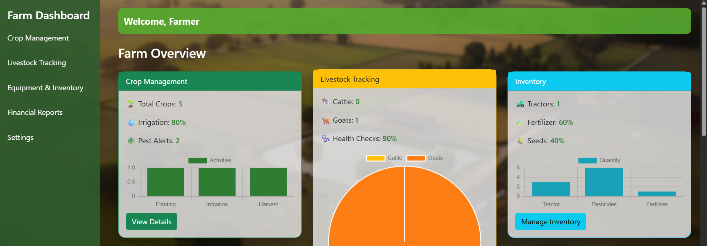
Introducing to Farm Management System One System, Total Farm Control
Presented By-
Argho Mondal (20232111010)
Ethun Mallick (20232110010)
MD. Asaduzzaman Redoy (20232116010)
Presented To-
Zahrul Zannat Peya
Assistant Professor
North Western University, Khulna

Slide 3


Let's meet Rahim and Karim!
Farmer Rahim
A successful, organized farmer
His crops grow on time
Cows stay healthy
Profits rise every season
Farmer Karim
Faces challenges every day
Always runs behind schedule
Forgets seed and fertilizer dates
Lose money every harvest.

Slide 4

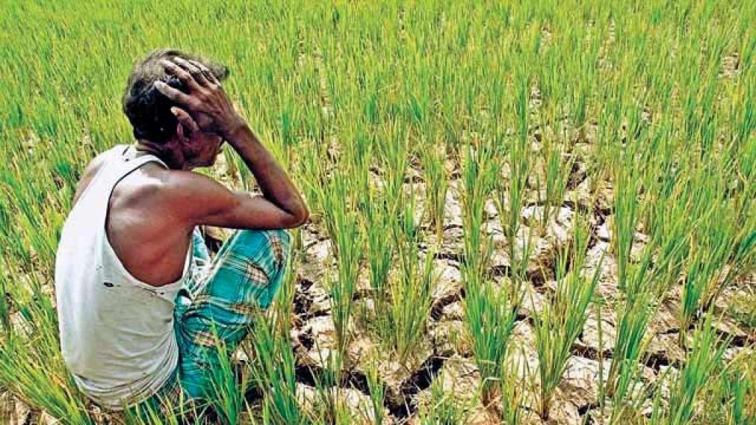
Problem Related to Crops
Unpredictable crop yields
Forgetting fertilizer schedules
Manual tracking of crop data
Crop Farming | Problems
1. Unpredictable crop yields | Hard to predict output each season
2. Forgetting fertilizer schedules | Sometimes overuse, sometimes miss applications
3. Difficulty planning irrigation | No organized schedule for watering crops
4. Manual tracking of crop data | Everything recorded on paper, prone to errors

Slide 5
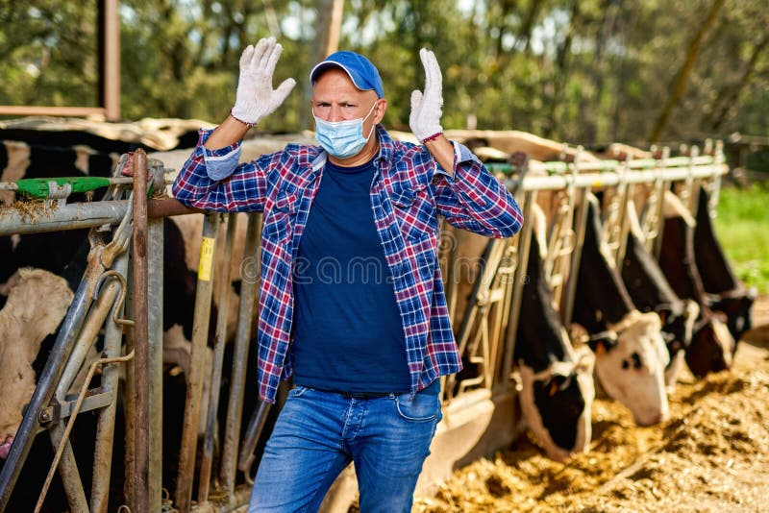
Problems Related to Dairy Farm
Trouble tracking feed & nutrition
Forgetting vaccination schedules
Manual milk production records
Financial losses due to mismanagement
Dairy Farm | Problems
1. Trouble tracking feed & nutrition | Hard to monitor daily feed for cows
2. Forgetting vaccination schedules | Risk of disease in livestock
3. Manual milk production records | Records often inaccurate or lost
4. Financial losses due to mismanagement | Mistakes directly reduce profit

Slide 6
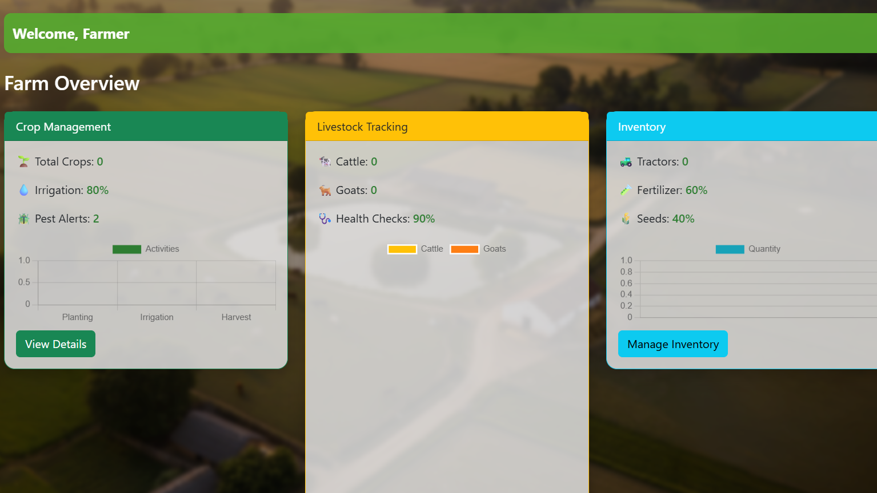
Common Solution!
Farm Management System
One platform for both crop and dairy farmers
Track crops, livestock, and farm activities digitally
Automated irrigation, fertilizer, and feed schedules
Keep all records organized and accessible
Make data-driven decisions to reduce waste and increase profit

Slide 7
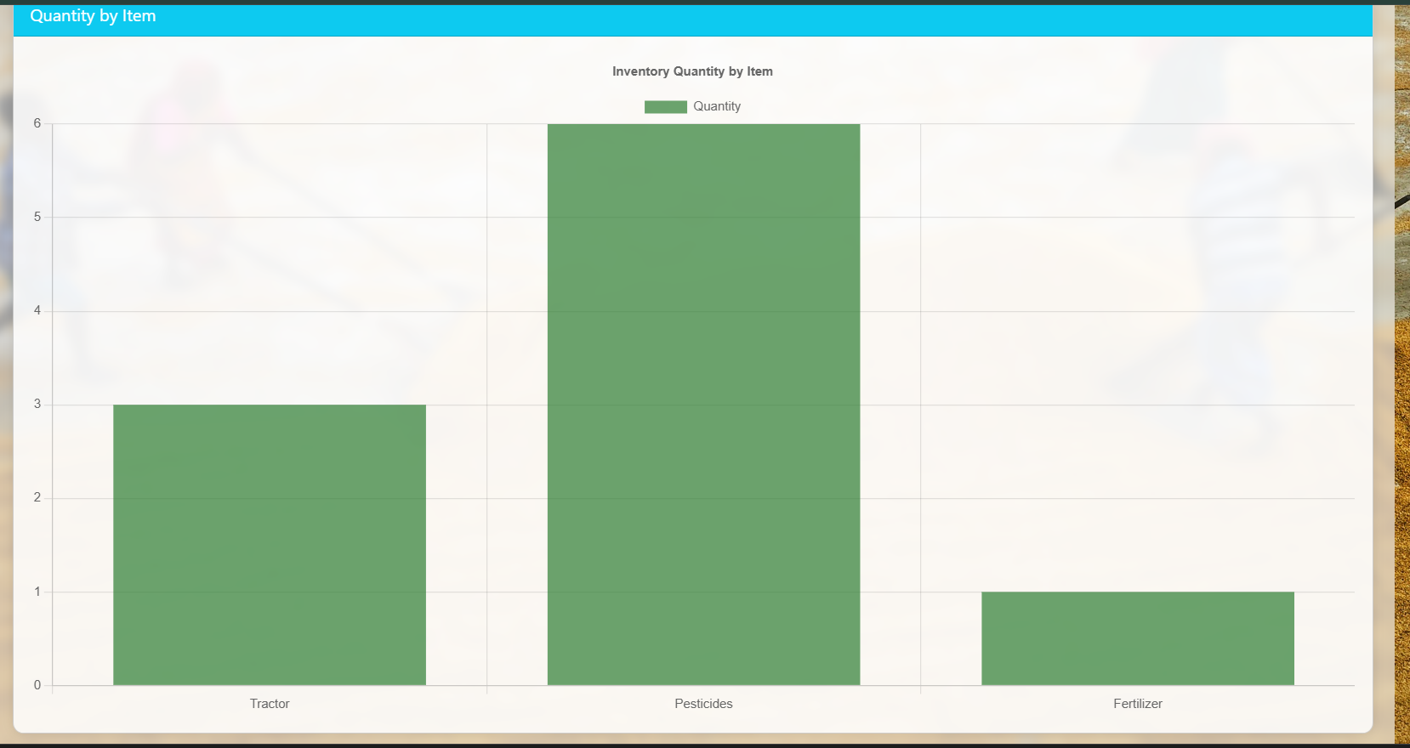
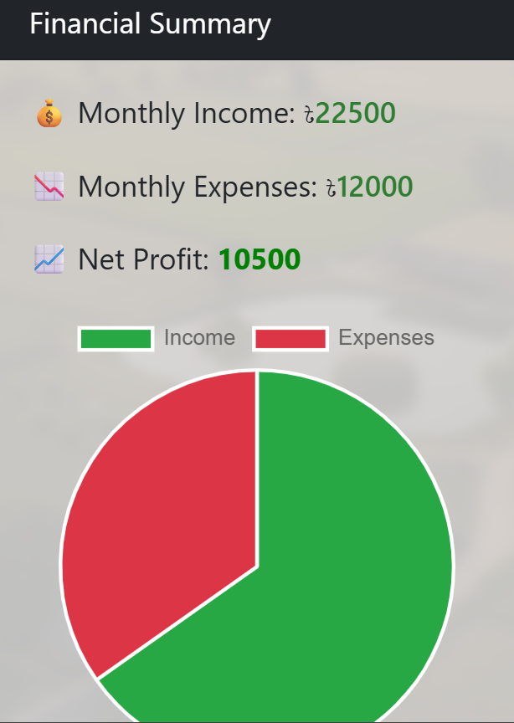
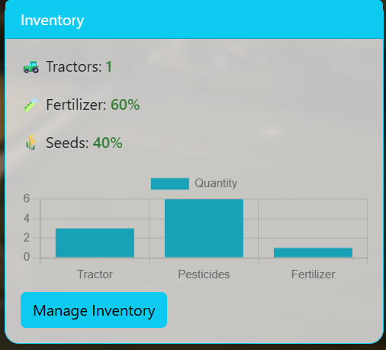
Features!
Crop Management
Livestock Management
Yield & Performance Tracking
Profit & Loss Monitoring
User Dashboard

Slide 8
Working Flow
Crop Management
Livestock Management
Inventory Management
Financial Reports

Slide 9
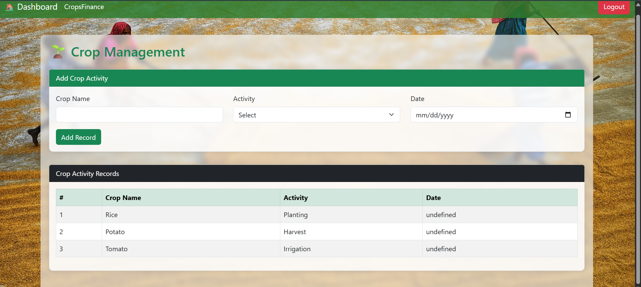
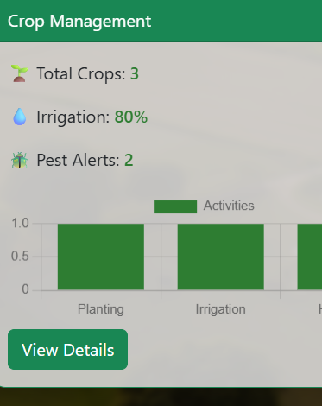
Crop Management
Input: Crop Name, Activity, Date
System: Records activities, schedules next tasks
Output: Table of crop activities, Graph of activity completion vs time

Slide 10
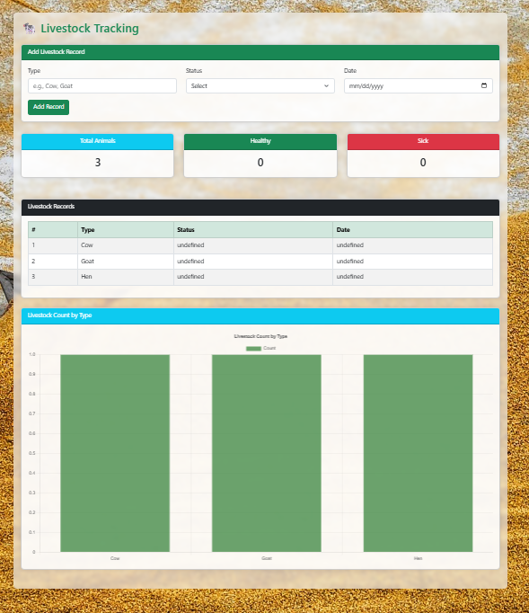
Livestock Management
Input: Animal Type, Status, Date
System: Records health, feeding, and other activities
Output: Table of livestock activities, Graph of health or activity status over time

Slide 11
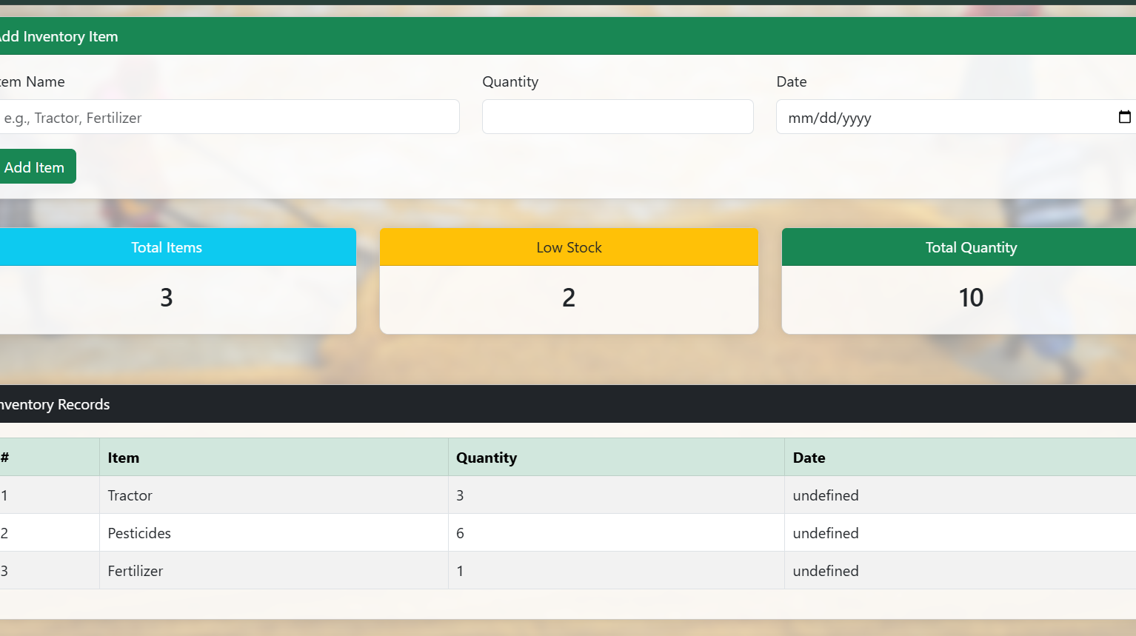
Inventory Management
Input: Item Name, Quantity
System: Records stock levels and usage
Output: Table of inventory, Graph of stock availability over time

Slide 12
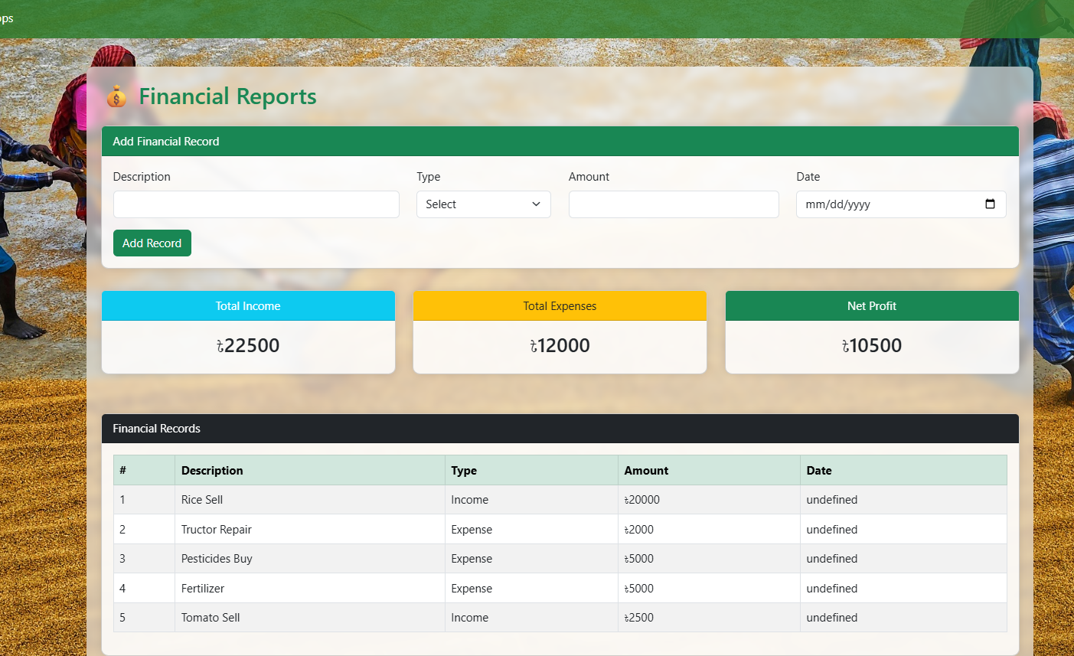
Financial Summary
Input: Description, Type (Income/Expense), Amount, Date
System: Records transactions and calculates profit/loss
Output: Table of transactions, Graph of income vs expenses over time

Slide 13
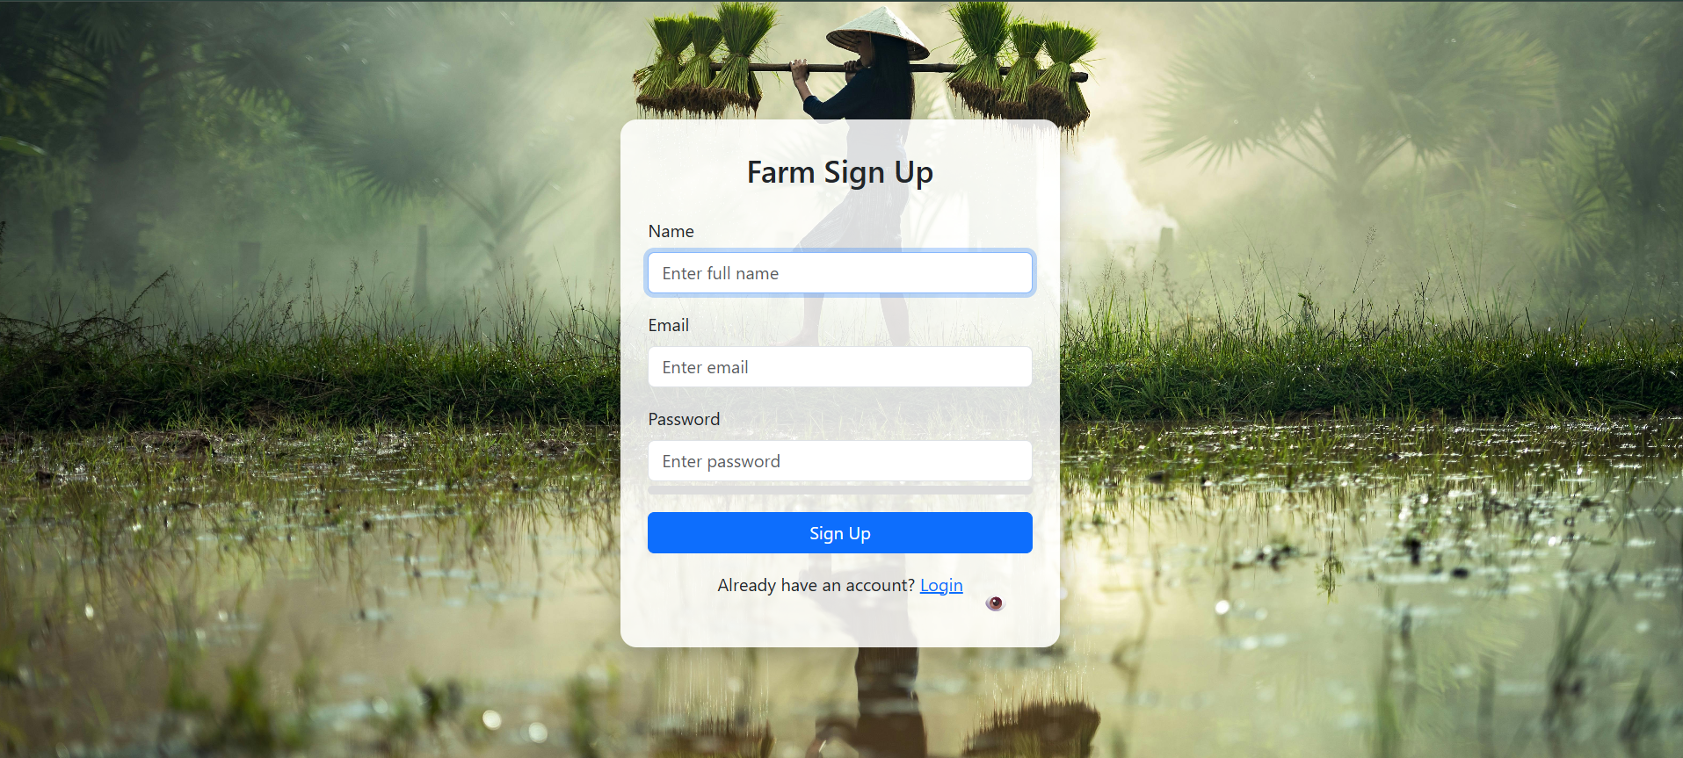
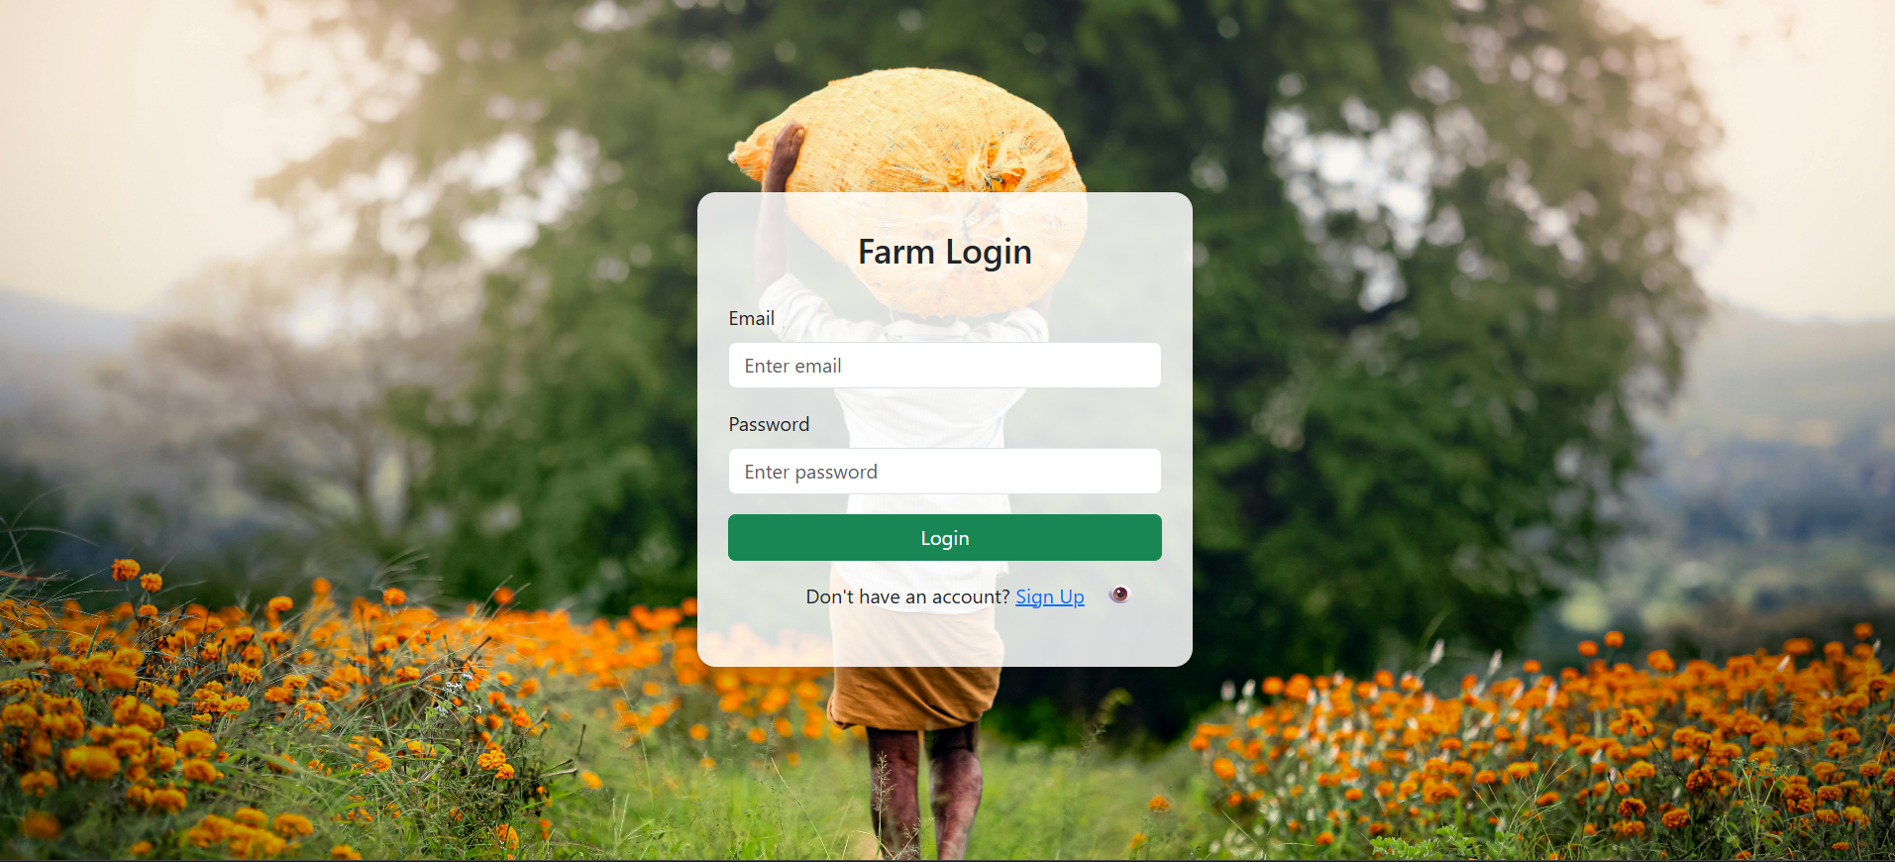
Start Farming Smarter in 2 Steps:
Create Account – Enter username, email, and password
Log In – Access all your farming tools

Slide 14
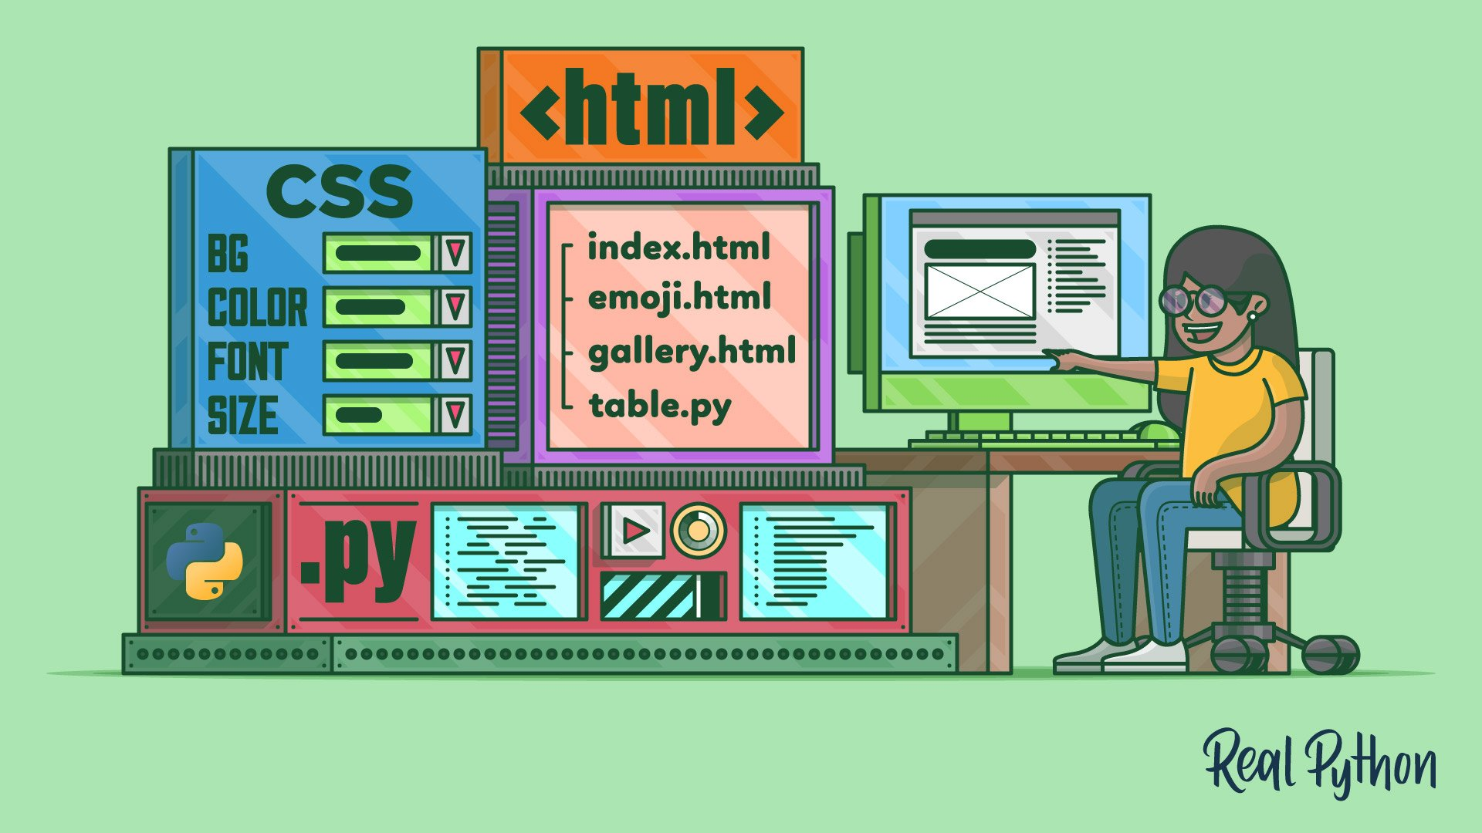


Technology Used
Frontend: HTML, CSS, JavaScript – for a responsive and user-friendly interface
Backend: Node.js & Express – to handle data and server logic
Database: MongoDB – stores crops, livestock, inventory, and financial data
Hosting:
Frontend → Netlify
Backend → Render

Slide 15


Benefits
Save Time
Reduce Errors
Better Planning
Data-Driven Decisions
All-in-One Platform

Slide 16
Future Enhancements
Mobile App: Access the system on smartphones and tablets
AI Predictions: Forecast crop yield and livestock performance
Automated Alerts: SMS or email notifications for important tasks
Multi-Farm Support: Manage multiple farms from one account
Advanced Analytics: Detailed charts and reports for better decision-making

Slide 17
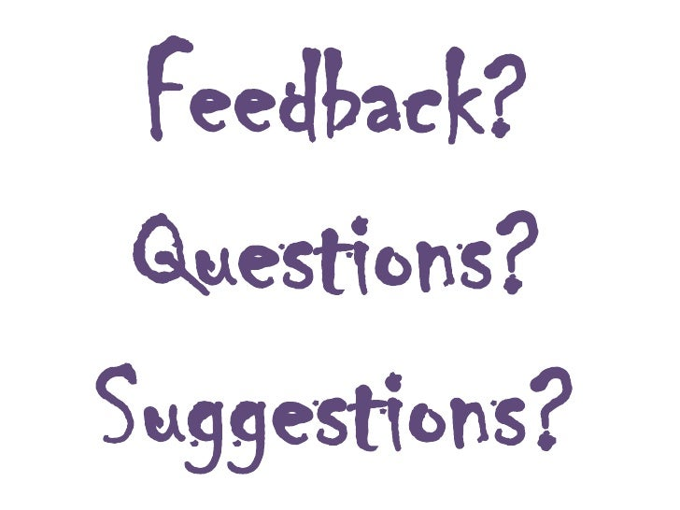
Thank You!
Questions & Feedback Welcome

